Slide 1


Data Analysis with Microsoft Excel

Slide 2




Introduction to Excel
Week 1: Agenda
Data Types
Cell Format, References
Sorting, Filtering
Data Manipulation
Custom List, Named Ranges
Data Cleaning, Data Validation
Data Visualization
Building Different Chart Types
Keyboard Shortcuts
www.dsa.az Bütün hüquqlar qorunur.
DATA SCIENCE ACADEMY
2

Slide 3
Stages of your data analysis work
Data Mining/Gathering/Entry
Data Cleaning
Data Analysis
Data Visualization
Data Presentation
www.dsa.az Bütün hüquqlar qorunur.
DATA SCIENCE ACADEMY
3

Slide 4


I
Introduction to Excel

Slide 5
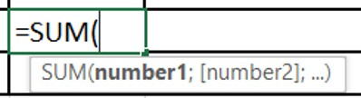



Data Type vs Cell Format
Data types | Format Cells
Text (“any symbol or text”) | Number & Text
Number (42; -5; 0.25…) | Date & Time
Boolean (false/true) | Currency & Accounting
Formula | Custom
Alignment Numbers Text | Format painter Trick: double click
www.dsa.az Bütün hüquqlar qorunur.
DATA SCIENCE ACADEMY
5

Slide 6

References
There are 4 types of cell references:
Relative Reference – A1
Absolute Reference – $A$1
Mix Reference – absolute column , relative row – $A1
Mix Reference – relative column, absolute row – A$1
Note: For references you can use F4 or FN+F4 together
www.dsa.az Bütün hüquqlar qorunur.
DATA SCIENCE ACADEMY
6

Slide 7
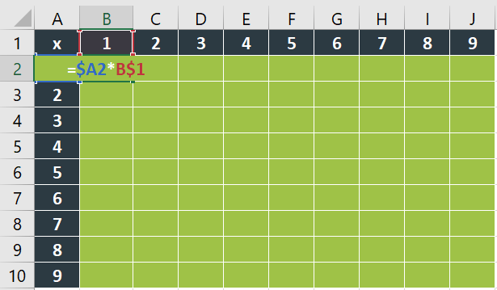

References
Click the cell B2
Type the equal sign (=)
Do one of the following: Type the reference directly in the cell or in the formula bar
Select A2 and reference column
Multiply: select B1 and reference row
Enter key to complete it
www.dsa.az Bütün hüquqlar qorunur.
DATA SCIENCE ACADEMY
7

Slide 8
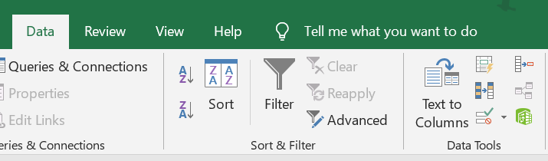
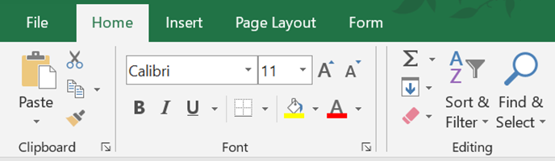
Sorting
1
2 ways to go to sorting options:
Click the Data tab.
In the Sort & Filter group, click Sort icon.
Click Home tab.
In the Editing group, click on Sort & filter icon.
2
www.dsa.az Bütün hüquqlar qorunur.
DATA SCIENCE ACADEMY
9

Slide 9
Sorting
Sorting by value (text, numbers, dates & times)
Sorting by format (cell color, font color, icon set)
Sorting by row
Multiple sorting
www.dsa.az Bütün hüquqlar qorunur.
DATA SCIENCE ACADEMY
10

Slide 10
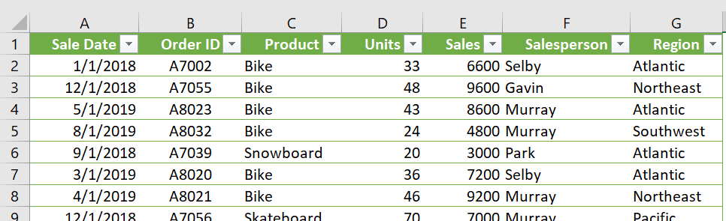
Sorting
Open “Filtering-Sorting, Custom list.xlsx”.
Task 1
Sort Sales Order by Smallest to largest.
www.dsa.az Bütün hüquqlar qorunur.
DATA SCIENCE ACADEMY
11

Slide 11
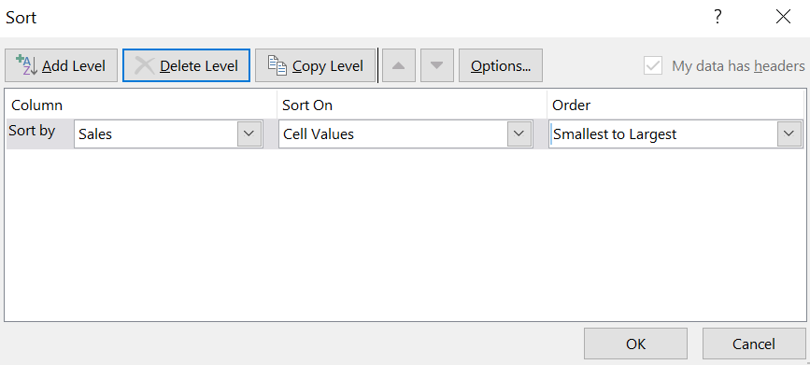
Sorting by value
1
Click Sort & Filter in Home Tab.
Choose
Sort by: Sales
Sort on: Cell Values
Order: Smallest to largest
2
www.dsa.az Bütün hüquqlar qorunur.
DATA SCIENCE ACADEMY
12

Slide 12
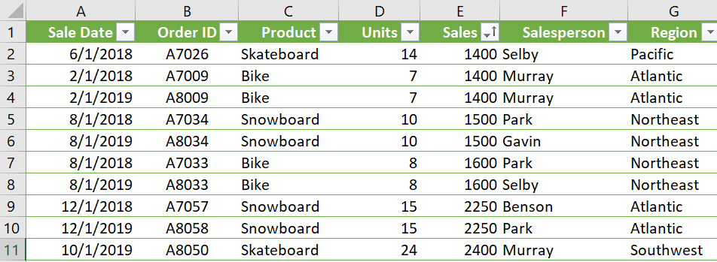
Sorting by Value - OUTPUT
Before sorting
After Sorting
www.dsa.az Bütün hüquqlar qorunur.
DATA SCIENCE ACADEMY
13

Slide 13
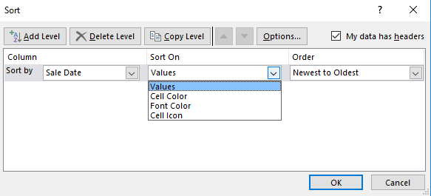
Format Sorting
Instructions:
Click Home tab
In the Editing group,
Click on Sort & filter icon
Click on Custom Sort
Sort by (choose variable/column)
Choose Sort on Cell Color/Font Color/Cell icon
Choose color format from the list
Click OK
www.dsa.az Bütün hüquqlar qorunur.
DATA SCIENCE ACADEMY
14

Slide 14
Sorting by Row
Instructions:
Click Home tab
In the Editing group,
Click on Sort & filter icon
Click on Custom Sort
Sort by (choose variable/column)
Choose Sort on Cell Color/Font Color/Cell icon
Choose color format from the list
Click OK
www.dsa.az Bütün hüquqlar qorunur.
DATA SCIENCE ACADEMY
15

Slide 15
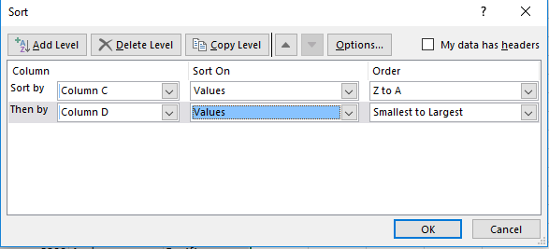
Multiple Sorting
Click Home tab
In the Editing group,
click on Sort & filter icon
Click on Custom Sort
Click on Add level
Choose Another Column
Choose Sort on values/format & Order
Click OK
*You can do the multiple sorting process for Sorting by Rows
www.dsa.az Bütün hüquqlar qorunur.
DATA SCIENCE ACADEMY
16

Slide 16
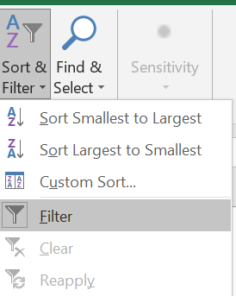
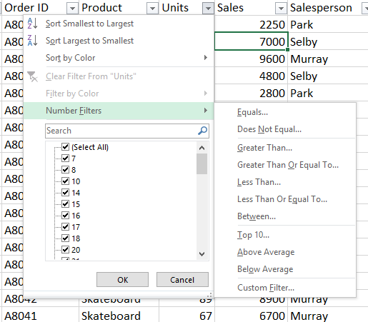
Filtering
Data Filtering :Text /Number filtering
Instructions:
Click Home tab
In the Editing group,
click on Sort & filter icon
Click on Filter
On your data click on funnel on top of column
Filter your data
Choose one of options for Text/Number filters
Click OK
www.dsa.az Bütün hüquqlar qorunur.
DATA SCIENCE ACADEMY
17

Slide 17
II
Data Manipulation

Slide 18
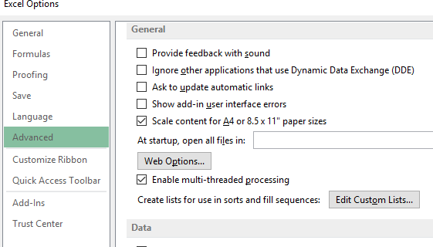
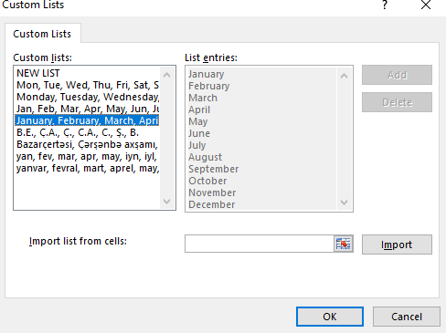
Custom list
File > Options > Advanced
Edit Custom Lists
Add new list
or
Import from range
1
2
www.dsa.az Bütün hüquqlar qorunur.
DATA SCIENCE ACADEMY
19

Slide 19
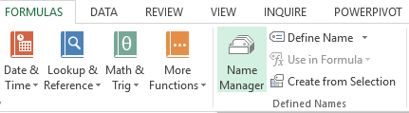
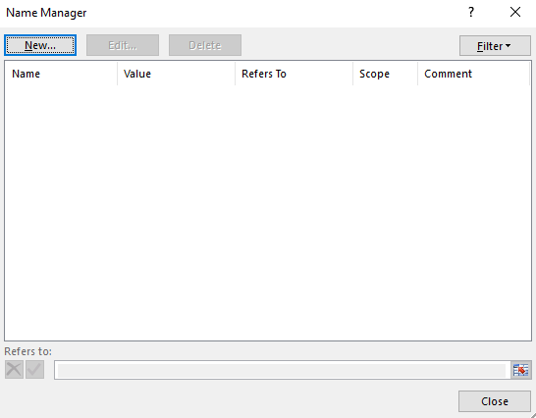
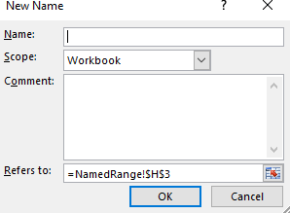
Named Ranges
Click Name Manager from Formulas tab
Select New…
Select range and give a name to it
www.dsa.az Bütün hüquqlar qorunur.
DATA SCIENCE ACADEMY
21

Slide 20
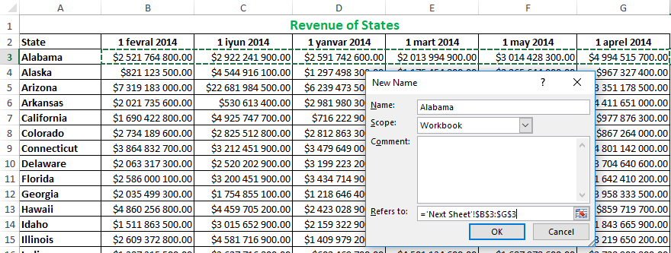
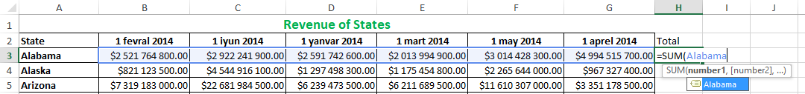
Named Ranges
Operations with Named Ranges:
Enter new Name Range
Select 6 month of revenue row for Alabama
Name it as “Alabama”
Create new column name as Total of 6 month
For calculation enter =sum(Alabama)
www.dsa.az Bütün hüquqlar qorunur.
DATA SCIENCE ACADEMY
22

Slide 21
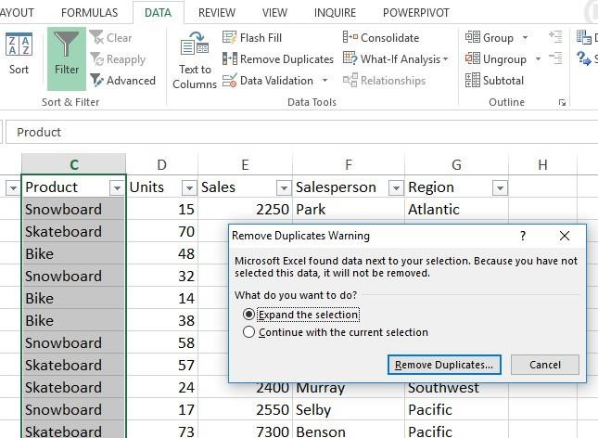
Data Cleaning
Removing duplicates:
Select Remove Duplicates from Data tab
Select Expand the selection
Click Remove Duplicates
www.dsa.az Bütün hüquqlar qorunur.
DATA SCIENCE ACADEMY
23

Slide 22
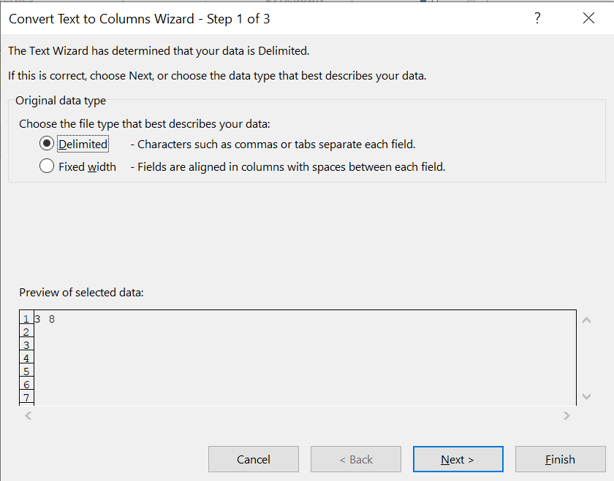
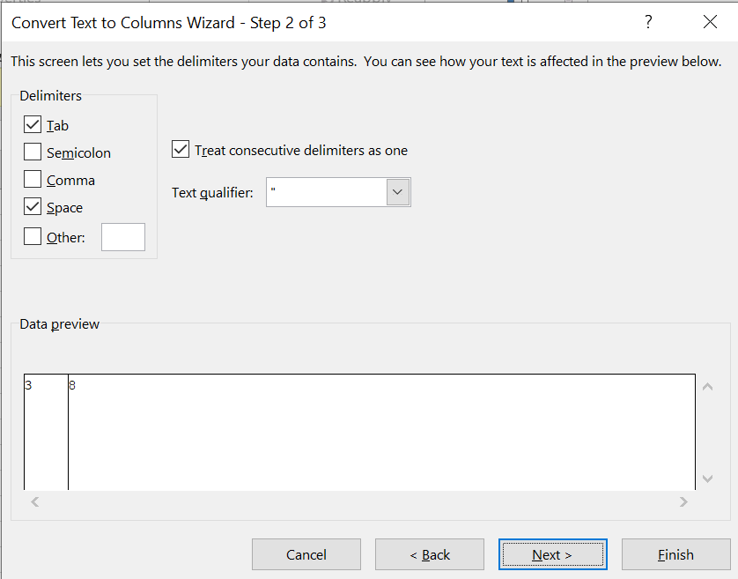
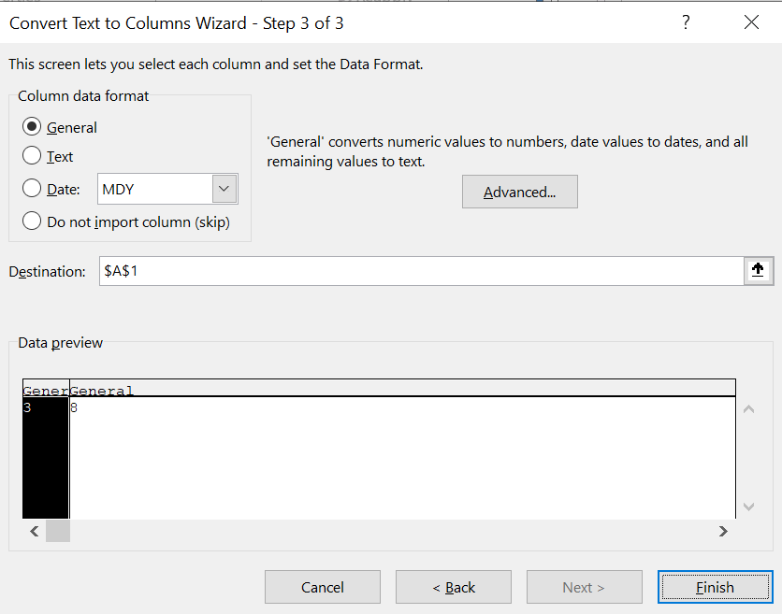
Data Cleaning
Click Text to column from Data tab
Select Delimited
Click Next. Select Tab and Comma.
Select other and write in highlighted are with what your text delimited
Then select Next and choose General
1
2
3
www.dsa.az Bütün hüquqlar qorunur.
DATA SCIENCE ACADEMY
24

Slide 23
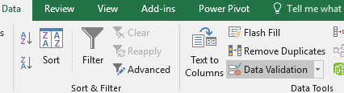
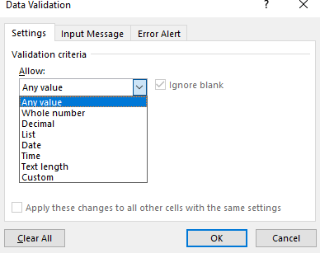
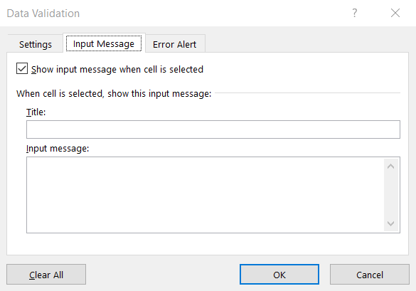
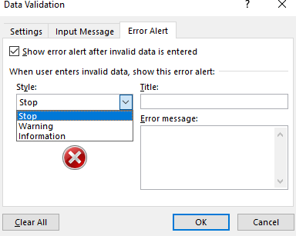
Data Validation
Select Data Validation from Data tab
On the Settings tab, under Allow, select one of the given options
On the Input Message tab, customize a message that users will see when entering data
On the Error Alert tab, select error style and customize error message
Click OK
www.dsa.az Bütün hüquqlar qorunur.
DATA SCIENCE ACADEMY
25

Slide 24
III
Data Visualization

Slide 25
Charts
Line Chart– When there is a trend
Column Chart– different categories
Bar Chart – When you have large list of categories
Pie Chart – When you want to show parts of total
Combo charts
Sparklines
www.dsa.az Bütün hüquqlar qorunur.
DATA SCIENCE ACADEMY
27

Slide 26
Charts
Charts
A chart helps you display your data into a graphical representation. There are many types of charts, but in this class, we'll focus on simple column, line, and pie charts.
Charts | Description
Pie Chart | Charts are used to compare proportions. Use it to show numbers that relate to a larger sum and always equal 100%.
Line Chart | Line charts are best used to show trends. Each data point is connected with lines, which makes it easier to see whether values are increasing or decreasing over time.
Column chart | Column charts are useful for showing data changes over a period of time or for illustrating comparisons among items. In column charts, categories are typically organized along the horizontal axis and values along the vertical axis.
Bar chart | A bar chart (or a bar graph) is one of the easiest ways to present your data in Excel, where horizontal bars are used to compare data values. Here’s how to make and format bar charts in Microsoft Excel.
Combo chart | To emphasize different kinds of information in a chart, you can combine two or more charts. For example, you can combine a line chart that shows price data with a column chart that shows sales volumes.
Sparklines | A sparkline is a tiny chart in a worksheet cell that provides a visual representation of data.
www.dsa.az Bütün hüquqlar qorunur.
DATA SCIENCE ACADEMY
28

Slide 27
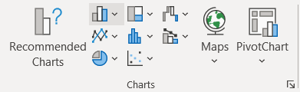
Charts
Inserting a Chart
The following instructions explain how to insert a chart into your worksheet.
Select the cells that you want to use in your chart, including column titles and row labels.
On the Insert tab, go to the Charts group.
Click the down arrow next to the type of chart you want to use.
When the menu appears, select the chart type of your choice.
The chart will appear on your worksheet.
www.dsa.az Bütün hüquqlar qorunur.
DATA SCIENCE ACADEMY
29

Slide 28
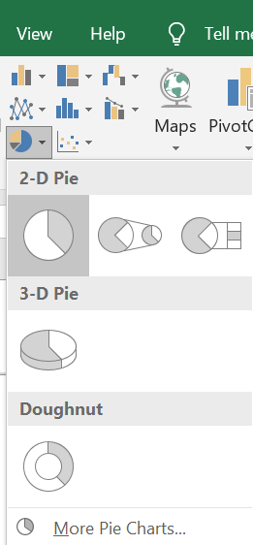
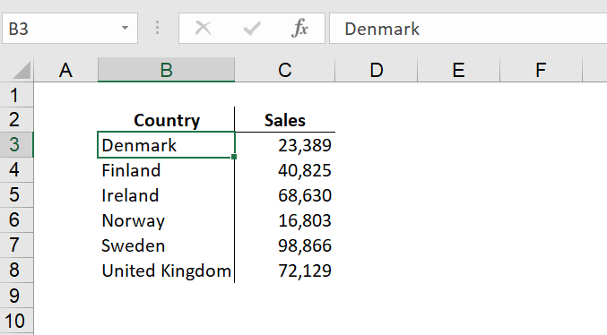
Pie Chart
Open “Charts.xlsx”(note this data is for all charts).
Select the cells that you want to use in your chart.
On the Insert tab, select 2D Pie Chart from Charts group.
2
1
www.dsa.az Bütün hüquqlar qorunur.
DATA SCIENCE ACADEMY
30

Slide 29
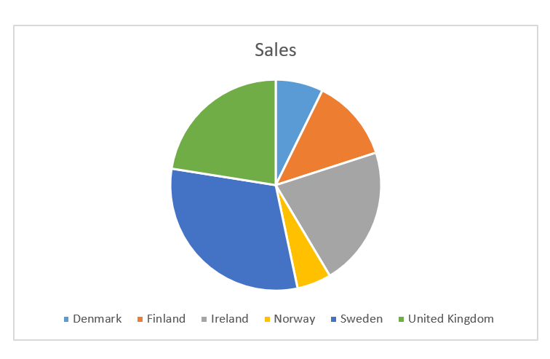
Pie Chart Output
www.dsa.az Bütün hüquqlar qorunur.
DATA SCIENCE ACADEMY
31

Slide 30
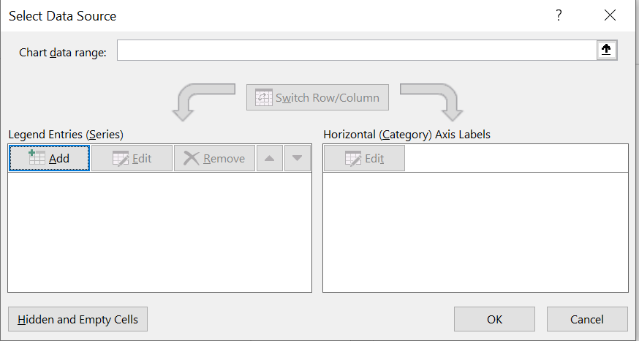
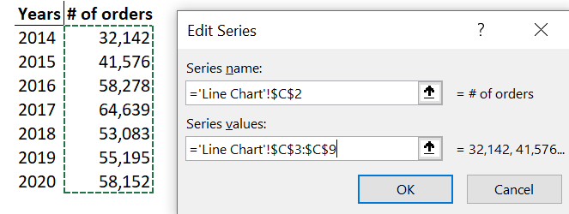
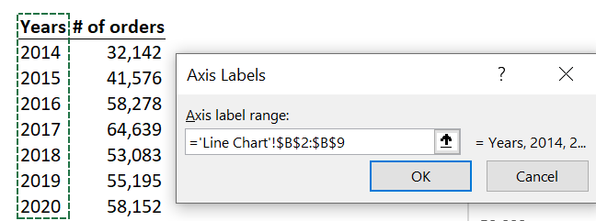
Line Charts
Line charts are best used to show trends. Each data point is connected with lines, which makes it easier to see whether values are increasing or decreasing over time.
Open “Charts.xlsx”(note this data is for all charts)
Select Line chart from Insert tab
Select chart area and click Select data from Design tab
Click add
Add given range to highlighted areas(1)
Next click edit from highlighted area(2)
Add given range to highlighted area (2)
www.dsa.az Bütün hüquqlar qorunur.
DATA SCIENCE ACADEMY
32

Slide 31
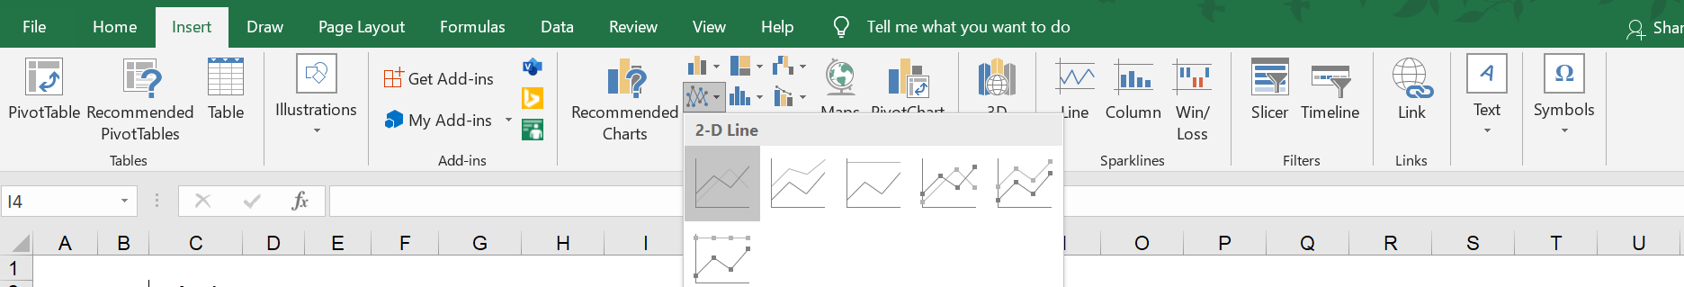
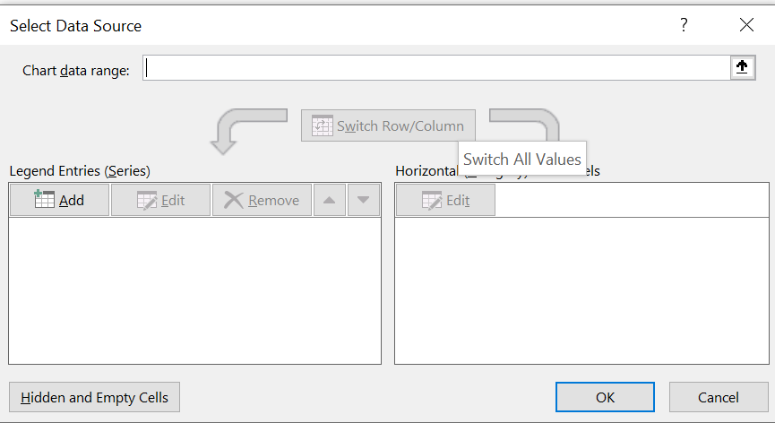
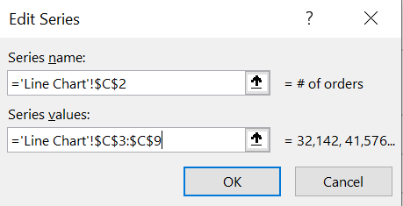
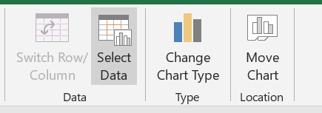
Line Chart
Select Line Chart from Insert Tab
Click Select Data from Chart Design Tab
Click Add in Select Data Source
www.dsa.az Bütün hüquqlar qorunur.
DATA SCIENCE ACADEMY
33

Slide 32
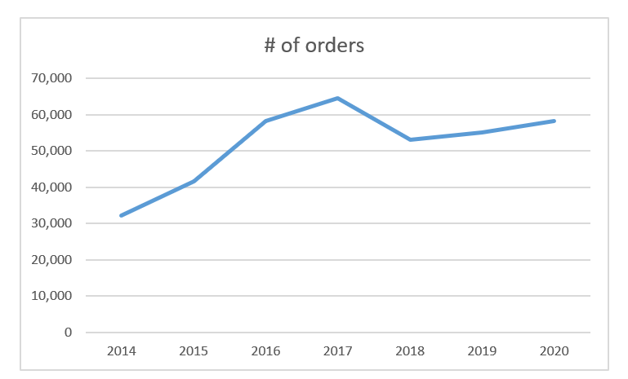
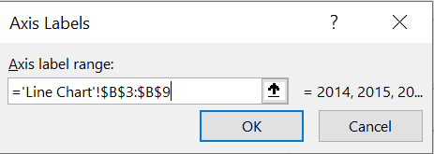
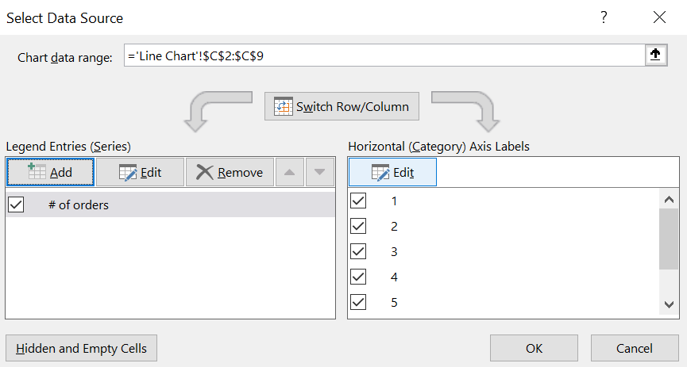
Click Edit from Select Data Source
Line Chart
OUTPUT
www.dsa.az Bütün hüquqlar qorunur.
DATA SCIENCE ACADEMY
34

Slide 33
Creative Excel use & Tips
Worksheets:
Zoom, Split, Freeze Panes
Protect:
Protect Sheet, Hide formula, Lock Cells
Working with Excel Tables
Formatting for printing
Go to Special & Select:
Delete Blank Rows, Copy Visible Cells Only
Quick Access Toolbar
Autofilter, Autofit Column/Row, Select Visible Cells
Creative Use of Find & Replace
Hyperlink
www.dsa.az Bütün hüquqlar qorunur.
DATA SCIENCE ACADEMY
35

Slide 34
Keyboard Shortcuts
Navigation&Selection | Description
Home | Select the first command on the menu when a menu or submenu is visible.
CTRL+Home | Move to the beginning of a worksheet.
TAB | Move the focus to commands on the ribbon.
SHIFT+TAB | Move to the previous cell in a worksheet or the previous option in a dialog.
CTRL+TAB | Paste
ENTER | Move active cell down in selection
SHIFT+ENTER | Move active cell up in selection
CTRL+ENTER | Complete entry and stay in same cell
CTRL+up/down/right/left | Move to top/bottom/right/left edge of data region
SHIFT+up/down/right/left | Extend selection by one cell up/down/right/left
CTRL+SHIFT+up/down/right/left | Extend the selection to the last cell up/down/right/left
www.dsa.az Bütün hüquqlar qorunur.
DATA SCIENCE ACADEMY
36

Slide 35
Keyboard Shortcuts
Navigation&Selection | Description
CTRL+A | Select entire worksheet
CTRL+Z/Y | Undo/Redo last action
SHIFT+SPACE | Select entire row
CTRL+SPACE | Select entire column
CTRL +ALT+ “+”/ CTRL +ALT+”-” | Zoom in/out
CTRL+N | To create a new workbook
CTRL+W | To close your current workbook
CTRL+C | To copy cells that are highlighted
CTRL+X | Move the selected cells
CTRL+V | Paste content at the insertion point, replacing any selection
CTRL+Alt+V | Open the Paste Special dialog.
CTRL+F | To search for anything in a workbook.
www.dsa.az Bütün hüquqlar qorunur.
DATA SCIENCE ACADEMY
36

Slide 36
Keyboard Shortcuts
Navigation&Selection | Description
CTRL+G | To jump to a certain area with a single command.
CTRL+H | To find and replace cell contents.
CTRL+Shift+L | Turn on/ off filters
Alt+PGDN/PGUP | Move one screen right/Move one screen down
Drag | Description
Drag | Drag and cut
CTRL+Drag | Drag and copy
Shift+Drag | Drag and insert
CTRL+Shift+Drag | Drag and insert copy
ALT+Drag | Drag to worksheet
www.dsa.az Bütün hüquqlar qorunur.
DATA SCIENCE ACADEMY
37

Slide 37
Keyboard Shortcuts
Formatting | Description
CTRL+B | To turn highlighted cells bold.
CTRL+U | To underline highlighted cells.
CTRL+I | To italicise cell contents.
CTRL+1 | To format the cell contents.
CTRL+9/CTRL+0 | To hide a row/ To hide a column.
CTRL+T | Insert table
CTRL+D | To fill the selected cell with the content of the cell right above.
CTRL+R | To fill the selected cell with the content of the cell on the left.
Formula | Description
F2 | activates the “editing” mode for the active cell
F4 | automatically makes the cell reference absolute
F9 | Calculates all worksheets in all open workbooks. Move the focus to commands on the ribbon.
www.dsa.az Bütün hüquqlar qorunur.
DATA SCIENCE ACADEMY
38

Slide 38
Thank you!

